Slide 1
Data Structure & Algorithm
Lecture 2: Array
Dr. Mohamed Ezz
Al-Azhar University

Slide 2
Lecture Content
Array Overview
The Basics of Arrays in Java
Operation on Array
  Insertion
  Searching (Linear , Binary )
  Deletion
The Duplicates Issue
Big O Notation
Cloning an Array
java.util.Arrays

Slide 3
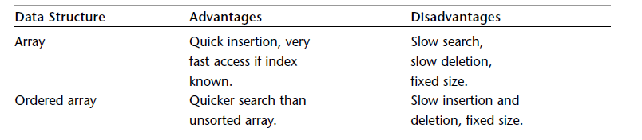
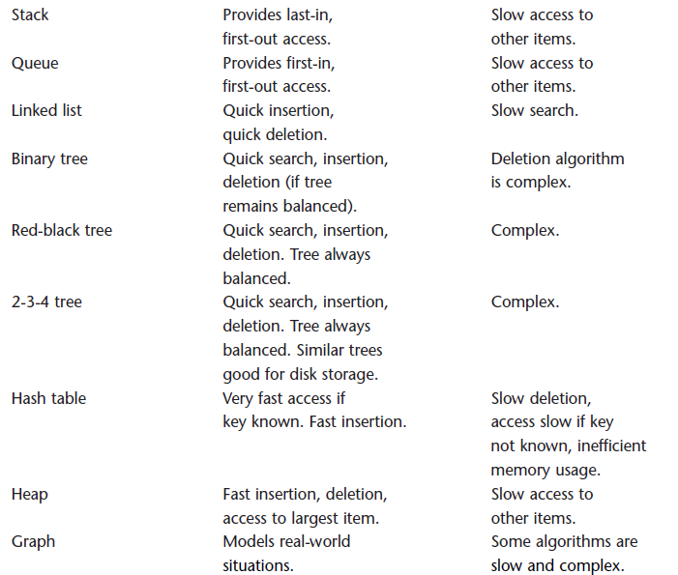
Major Data Storage Structure

Slide 4
Operation on Data Structure
The important operation on Data Structure:
  Insert a new data item.
  Delete a specified item.
  Search for a specified item.
  Sort items in DS to simplify search

Slide 5
The array data structure
An array is an indexed sequence of components/elements that are numbered 0, 1, 2, ...
The element numbers are called index numbers.
Array elements can be accessed by their index numbers using the subscript operator [], as a[0], a[1], a[2], and so on.
Typically, the array occupies sequential storage locations
The length of the array is determined when the array is created, and cannot be changed
Each component of the array has a fixed, unique index
Indices range from a lower bound to an upper bound

Slide 6
Arrays in Java I
Array indices are integers
An array of length n has bounds 0 and n-1
Arrays are homogeneous (one type)
Arrays are reflective
  a.length is the length of array a
  a.getClass() is the type of array a
Array as an ADT
  It’s abstract because the implementation is hidden: all access is via the defined operations

Slide 7
Arrays in Java II
Creating an Array
  int[] intArray; // defines a reference to an array
  intArray = new int[100]; // creates the array, and
  int[] intArray = new int[100]; // or define ref. & create array in one step
  int intArray[] = new int[100]; // alternative syntax
Accessing Array Elements
  temp = intArray[3]; // get contents of fourth element of array
  intArray[7] = 66; // insert 66 into the eighth cell
  int arrayLength = intArray.length; // find array size
Initialization
int[] intArray = { 0, 3, 6, 9, 12, 15, 18, 21, 24, 27 };//create, init same in one step
intArray[0]=4; // or element by element
intArray[1]=7;

Slide 8
Arrays in Java III
Here’s one way to visualize an array in Java:
int [] myArray;
myArray = new int[6];
myArray
Initialize array:
myArray [0]=17;
myArray [0]=23;
myArray [0]=94;
myArray [0]=12;
myArray [0]=55;
myArray [0]=75;
0
1
2
3
17
23
94
12
55
74
4
5

Slide 9
Two-dimensional arrays II
In a 2D array, we generally consider the first index to be the row, and the second to be the column: a[row, col]
columns
0 1 2 3 4
0
1
2
3
0,0
0,1
0,2
0,3
0,4
rows
1,0
1,1
1,2
1,3
1,4
2,0
2,1
2,2
2,3
2,4
3,0
3,1
3,2
3,3
3,4
In most languages we don’t need to know the implementation--we work with this abstraction

Slide 10
2D arrays in Java
Java doesn’t have “real” 2D arrays, but array elements can themselves be arrays:
  int x[][] denotes an array x of array components, each of which is an array of integer components
We can define the above array like this:
x = new int[5][8];
and treat it as a regular 2D array
This is an array of 5 arrays
  Each subarray is an array of 8 ints
However, we can do fancier things than this with arrays in Java

Slide 11
Ragged arrays
int ragged[][] = new int[4][];
for (int i = 0; i < 4; i++) {
ragged[i] = new int[i + 1];
}
0
1
2
3
0
1
2
3
0
10
11
20
21
22
30
31
32
33
for (int i = 0; i < 4; i++) {
for (int j = 0; j < ragged[i].length; j++) {
ragged[i][j] = 10 * i + j;
}
}
Notes:
غير منظم

Slide 12
Example 1
public class ArrayTest1 {
public static void main(String[] args) {
long[] arr; // reference to array
arr = new long[100]; // make array
int nElems = 0; // number of items
int j; // loop counter
//--------------------------------------------------------------
arr[0] = 77; // insert 10 items
arr[1] = 99;
arr[2] = 44;
arr[3] = 55;
arr[4] = 22;
arr[5] = 88;
arr[6] = 11;
nElems = 7; // now 7 items in array
//--------------------------------------------------------------
for (j = 0; j < nElems; j++) // display items
{ System.out.print(arr[j] + ""); }
System.out.println("");
} // end main()
}

Slide 13
Inserting an element into unsorted array
Suppose we want to insert the value 8 into this array
1
3
54
7
12
8
17
2
22
We can do this by assign value to last location
1
3
54
7
12
8
17
2
22
8
• its very fast operation → one operation O(1)

Slide 14
Example: Insert into unsorted Array
public class ArrayTest1 {
public static void main(String[] args) {
long[] arr; // reference to array
arr = new long[100]; // make array
int nElems = 0; // number of items
int j; // loop counter
//--------------------------------------------------------------
arr[0] = 77; // insert 10 items
arr[1] = 99;
arr[2] = 44;
arr[3] = 55;
arr[4] = 22;
arr[5] = 88;
arr[6] = 11;
nElems = 7; // now 7 items in array
//--------------------------------------------------------------
for (j = 0; j < nElems; j++) // display items
{ System.out.print(arr[j] + ""); }
System.out.println("");
//--------------------------------------------------------------
arr[nElems] = 33; // element added to end
nElems++; // increment size
} // end main()
}//end class

Slide 15
Inserting an element into sorted array
Suppose we want to insert the value 8 into this sorted array (while keeping the array sorted)
1
3
3
7
12
14
17
19
22
30
We can do this by shifting all the elements after the mark right by one location
  Of course, we have to discard the 30 when we do this
1
3
3
7
8
12
14
17
19
22
30
• Moving all those elements makes this a slow operation (linear in the size of the array) →O(n)

Slide 16
Example: Insert into sorted Array
public class ArrayTest1 {
public static void main(String[] args) {
long[] arr; // reference to array
arr = new long[100]; // make array
int nElems = 0; // number of items
int j; // loop counter
//--------------------------------------------------------------
arr[0] = 11; // insert 10 items
arr[1] = 22;
arr[2] = 44;
arr[3] = 55;
arr[4] = 66;
arr[5] = 77;
arr[6] = 88;
nElems = 7; // now 7 items in array
//--------------------------------------------------------------
for (j = 0; j < nElems; j++) // display items
{ System.out.print(arr[j] + ""); }
System.out.println("");
//--------------------------------------------------------------
long e_add= 33; //element to added
j= nElems-1; //point to last element
while( arr[j] > e_add){
arr[j+1]= arr[j]; //shift element
j--;
}
arr[j+1]= e_add;
nElems++;
//--------------------------------------------------------------
for (j = 0; j < nElems; j++) // display items
{ System.out.print(arr[j] + ""); }
System.out.println("");
}//end main } //end class

Slide 17
Deleting an element from an array
Deleting an element is similar--again, we have to move all the elements after it
1
3
3
7
8
12
14
17
19
22
1
3
3
7
12
14
17
19
22
?
Deletion is a slow operation; we don’t want to do it very often
Deletion leaves a “vacant” location at the end
  How do we mark it vacant?
    Every bit pattern represents a valid integer
    We must keep a count of how many valid elements are in the array

Slide 18
Example : Delete element
public class ArrayTest1 {
public static void main(String[] args) {
long[] arr; // reference to array
arr = new long[100]; // make array
int nElems = 0; // number of items
int j; // loop counter
//--------------------------------------------------------------
arr[0] = 77; // insert 10 items
arr[1] = 99;
arr[2] = 44;
arr[3] = 55;
arr[4] = 22;
arr[5] = 88;
arr[6] = 11;
nElems = 7; // now 7 items in array
//--------------------------------------------------------------
for (j = 0; j < nElems; j++) // display items
{ System.out.print(arr[j] + ""); }
System.out.println("");
//--------------------------------------------------------------
long searchKey = 55; // delete item with key 55
for (j = 0; j < nElems; j++) // look for it
{
if (arr[j] == searchKey) {
break;
}
}
// move higher ones down
for (int k = j; k < nElems - 1; k++)
{
arr[k] = arr[k + 1];
}
nElems--; // decrement size
//--------------------------------------------------------------
for (j = 0; j < nElems; j++) // display items
{ System.out.print(arr[j] + ""); }
System.out.println("");
}//end main } //end class

Slide 19
Search an element from an array
We have two type of search depend on array type:
 | unsorted array | sorted array
Linear Search | Applicable | Applicable
Binary Search | Not Applicable | Applicable

Slide 20
Linear Search
Looking for element form start of array till found it
Search for 8
Sequential search algorithm:
  (Postcondition: either the index i is returned where si = x, or –1 is returned.)
  1. Repeat steps 2, for i = 0 to n – 1.
  2. If si = x, return i .
  3. Return –1.
1
3
3
7
8
12
14
17
19
22
Notes:
ثابتةInvariant

Slide 21
Example: Linear Search
public class ArrayTest1 {
public static void main(String[] args) {
long[] arr; // reference to array
arr = new long[100]; // make array
int nElems = 0; // number of items
int j; // loop counter
//--------------------------------------------------------------
arr[0] = 77; // insert 10 items
arr[1] = 99;
arr[2] = 44;
arr[3] = 55;
arr[4] = 22;
arr[5] = 88;
arr[6] = 11;
nElems = 7; // now 7 items in array
//--------------------------------------------------------------
for (j = 0; j < nElems; j++) // display items
{ System.out.print(arr[j] + ""); }
System.out.println("");
//--------------------------------------------------------------
long searchKey = 88; // find item with key 88
for (j = 0; j < nElems; j++) // for each element,
{
if (arr[j] == searchKey) // found item?
{
break;
}
} // yes, exit before end
if (j == nElems) // at the end?
{ // yes
System.out.println("Can’t find " + searchKey);
} else { // no
System.out.println("Found in:" + j);
}
}//end main } //end class

Slide 22
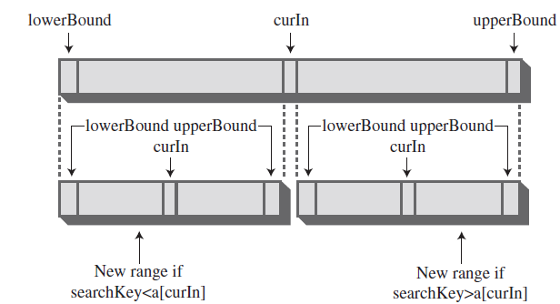
Binary Search
The binary search similar to look up a word in a dictionary.

Slide 23
Binary Search
The binary search similar to look up a word in a dictionary.
The binary algorithm:
  (Precondition: s = {s₀, s₁, . . ., s_{n–1}} is a sorted sequence of n values of the same type as x.)
  (Postcondition: either the index i is returned where si = x, or –1 is returned.)
  1. Let ss be a subsequence of the sequence s, initially set equal to s.
  2. If the subsequence ss is empty, return –1.
  3. Let si be the middle element of ss.
  4. If si = x, return its index i .
  5. If si < x, repeat steps 2–6 on ss = the subsequence that lies above si.
  6. Repeat steps 2–6 on ss = the subsequence that lies below si.

Slide 24
Example:Binary Search
public class ArrayTest1 {
public static void main(String[] args) {
long[] arr; // reference to array
arr = new long[100]; // make array
int nElems = 0; // number of items
int j; // loop counter
//--------------------------------------------------------------
arr[0] = 77; // insert 10 items
arr[1] = 99;
arr[2] = 44;
arr[3] = 55;
arr[4] = 22;
arr[5] = 88;
arr[6] = 11;
nElems = 7; // now 7 items in array
//--------------------------------------------------------------
for (j = 0; j < nElems; j++) // display items
{ System.out.print(arr[j] + ""); }
System.out.println("");
long searchKey= 88;
j= find(searchKey)
if (j == nElems) // at the end?
{ // yes
System.out.println("Can’t find " + searchKey);
} else { // no
System.out.println("Found in:" + j);
}
}//end main

Slide 25
Example:Binary Search-cont.
  public static int find(long searchKey){
    int lowerBound = 0;
    int upperBound = nElems-1;
    int curIn;
    while(true)
    {
    curIn = (lowerBound + upperBound ) / 2;
    if(a[curIn]==searchKey)
    return curIn; // found it
    else if(lowerBound > upperBound)
    return nElems; // can’t find it
    else // divide range
    {
    if(a[curIn] < searchKey)
    lowerBound = curIn + 1; // it’s in upper half
    else
    upperBound = curIn - 1; // it’s in lower half
    } // end else divide range
    } // end while
  }
} //end class

Slide 26
Running Time: seqSearch()
Best case: Find target at index 0.
T(n) = 1
Worst case: Find target at index n-1 or not finding it.
T(n) = n
Average case: Average of the number of comparisons to find a target at any position.
T(n) = (1+2+3...+n)/n = n(n+1)/2 * (1/n)
= (n+1)/2

Slide 27
Running Time: binSearch()
Best case: Target found at first midpoint.
T(n) = 1
Worst case: Length of sublists halves at each iteration.
T(n) = (int) log₂n + 1
Average case: A fancy analysis shows:
T(n) = (int) log₂n
Notes:
  log₂(n) = log₁₀(n) * 3.322

Slide 28
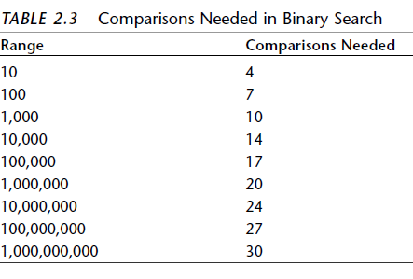

Slide 29
Big-Oh Notation
Big-Oh, O(n) is a simpler version of T(n) that only uses the 'biggest' term of the T(n) equation, without constants.
  e.g. if T(n) = 8n³+5n²-11n+1,
  then T(n) is O(n³).
  The sort is O(n²).
  The average case for seqSearch is O(n).
  The worst case for binSearch is O(log₂n).
  Constant time: T(n) is O(1) when its running time is independent of the n value

Slide 30
Big O Notation
The idea in Big O notation isn’t to give actual figures for running times but to convey how the running times are affected by the number of items.
This is the most meaningful way to compare algorithms, except perhaps actually measuring running times in a real installation
Algorithm | Running Time in Big O Notation
Linear search | O(N)
Binary search | O(log N)
Insertion in unordered array | O(1)
Insertion in ordered array | O(N)
Deletion in unordered array | O(N)
Deletion in ordered array | O(N)

Slide 31
T() Equations

Slide 32
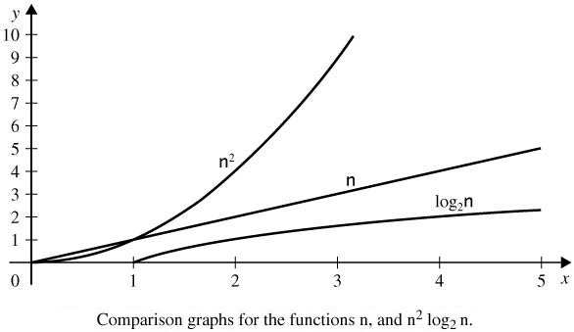
T() Graphs

Slide 33
The Duplicates Issue
What if the array accept duplicate element ?
 | No Duplicates | Duplicates OK
Searching | N/2 comparisons | N comparisons
Insertion | No comparisons, one move | N comparisons , one move
Deletion | N/2 comparisons, N/2 moves | N comparisons, more than N/2 moves

Slide 34
Cloning an Array
public class DuplicateArray {
public static void main(String[] args) {
int[] a = {22, 44, 66, 88};
int[] c = a;
int[] b = (int[]) a.clone(); // duplicate a[] in b[]
print(a);
print(b);
print(c);
a[1] = 33;
b[1] = 55;
c[1] = 77;
System.out.println("-----------------");
print(a);
print(b);
print(c);
}
public static void print(int[] a) {
System.out.printf("{%d", a[0]);
for (int i = 1; i < a.length; i++) {
System.out.printf(", %d", a[i]);
}
System.out.println("}");
}
}

Slide 35
java.util.Arrays
(sort,binarySearch, fill, and equals)
the Arrays class from the java.util package to access the sort(), binarySearch(), fill(), and equals() methods
import java.util.Arrays;
public class TestArrayUtil {
public static void main(String[] args) {
int[] a = {44, 77, 55, 22, 99, 88, 33, 66};
print(a);
Arrays.sort(a);
print(a);
int k = Arrays.binarySearch(a, 44);
System.out.printf("Arrays.binarySearch(a, 44): %d%n", k);
k = Arrays.binarySearch(a, 46);
System.out.printf("Arrays.binarySearch(a, 45): %d%n", k);
int[] b = new int[8];
print(b);
Arrays.fill(b, 55);
print(b);
System.out.println("Arrays.equals(a,b): " + Arrays.equals(a, b));
}

